Slide 1
Statistical Analysis – 3
Session 1
Multiple Regression

Slide 2
Course Outline
Session | Topic | Materials
1. | Introduction to Multiple Linear Regression, Omnibus test, Adjusted R² | Case: United Technologies of India
2. | Dummy Variable Regression and Interaction Effects Omitted Variable Bias | Case: The Gender Divide
3. | Issues in Multiple Regression Analysis and Testing assumptions: Multicollinearity, VIF, Remedies for Multicollinearity etc. | Case: United Technologies of India
4. | Variable Selection and other issues in multiple regression | Practical Regression: Regression Basics
5. | Introduction to Panel Data Regression Experiments with Regression | Case: Guest First Hotel (B) (Homework)

Slide 3
Evaluation
Component | Basis of Evaluation | Weight | Coding Scheme
Homework | Individual | 20% | 0N
Group Assignment | Group (3 to 4 students) | 40% | 1N
Final Exam | Individual | 40% | 3N-b

Slide 4
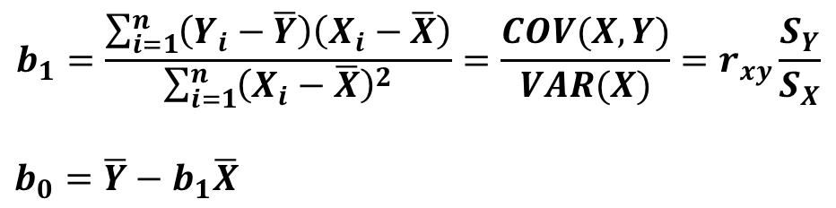
SLR - Review
$$b_{1}=\frac{\sum_{i=1}^{n}{\left(Y_{i}−\overline{Y}\right)\left(X_{i}−\overline{X}\right)}}{\sum_{i=1}^{n}{{\left(X_{i}−\overline{X}\right)}^{2}}}=\frac{COV(X,Y)}{VAR(X)}=r_{xy}\frac{S_{Y}}{S_{X}}$$
$$b_{0}=\overline{Y}−b_{1}\overline{X}$$
What happens if X and Y are standardized values?

Slide 5
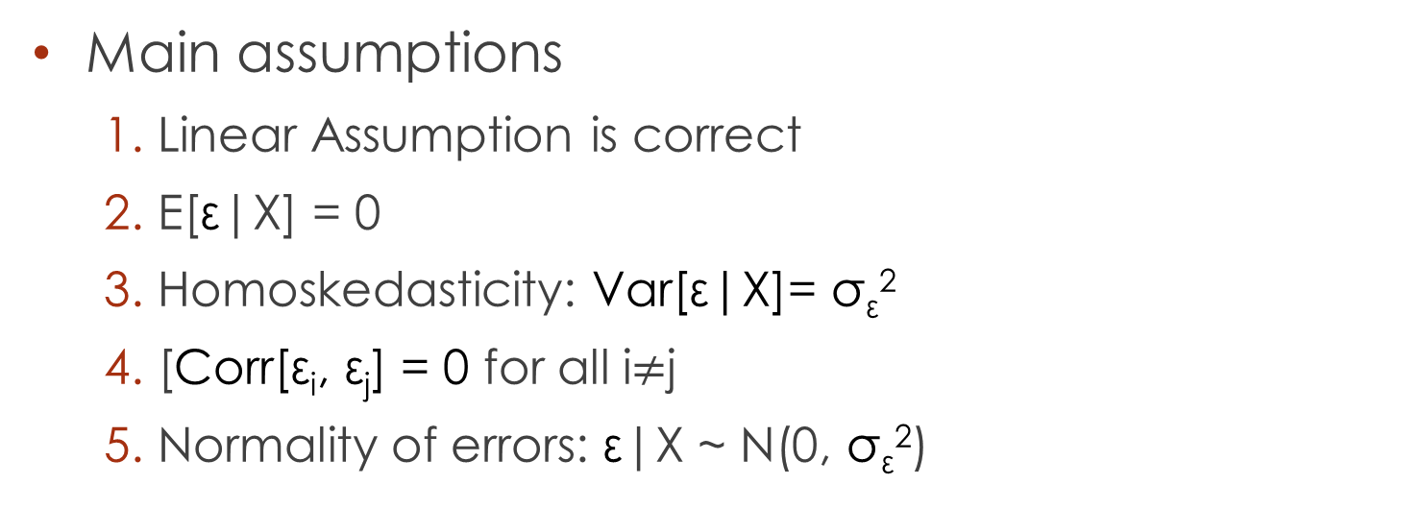
SLR Assumptions
Main assumptions
  Linear Assumption is correct
  E[ε|X] = 0
  Homoskedasticity: Var[ε|X]= σ_{ε}²
  [Corr[ε_{i}, ε_{j}] = 0 for all i$≠$j
  Normality of errors: ε|X ~ N(0, σ_{ε}²)

Slide 6
Learning Objectives
What is the interpretation of coefficients in multiple regression?
How to assess goodness of fit in multiple regression?
What are the key assumptions underlying multiple regression?
How to make statistical inference about individual variables and the full model?

Slide 7
How are you on Matrix Algebra?
What is a matrix?
Matrix Addition
Matrix Multiplication
Matrix Inverse
Do it in Excel

Slide 8
Multiple Regression Model and Equation
The response variable is a linear function of more than one predictor variable in the population (say k)
The multiple regression equation is therefore
β_{j} (partial coefficient) denotes the expected (or average) change in Y when X_{j} changes by one unit holding everything else fixed (controlling for all other variables)
Notes:
Emphasize the interpretation of partial coefficient.

Slide 9
United Technologies

Slide 10
Correlation Matrix
 | SALES | MATERIAL | T2 | OTINC | EMPL | INT | T | PBT
SALES | 1.0000
MATERIAL | 0.9904 | 1.0000
T2 | 0.9619 | 0.9424 | 1.0000
OTINC | 0.8653 | 0.8085 | 0.8039 | 1.0000
EMPL | 0.7449 | 0.7291 | 0.8717 | 0.5492 | 1.0000
INT | 0.9757 | 0.9570 | 0.9486 | 0.8756 | 0.7110 | 1.0000
T | 0.8841 | 0.8627 | 0.9713 | 0.7092 | 0.9576 | 0.8618 | 1.0000
PBT | 0.9307 | 0.8807 | 0.9546 | 0.8854 | 0.7785 | 0.9337 | 0.9081 | 1.0000

Slide 11
Sales Vs. Material
Launch Poll 1
Regression Statistics
Multiple R | 0.9904
R Square | 0.9809
Adjusted R Square | 0.9799
Standard Error | 3310.53
Observations | 20
ANOVA
 | df | SS | MS | F | Significance F
Regression | 1 | 1.01E+10 | 1.01E+10 | 925.0298 | 6.29E-17
Residual | 18 | 1.97E+08 | 10959608
Total | 19 | 1.03E+10
 | Coefficients | Standard Error | t Stat | P-value | Lower 95% | Upper 95%
Intercept | 1698.74 | 1024.44 | 1.66 | 0.11 | -453.53 | 3851.02
MATERIAL | 1.89 | 0.06 | 30.41 | 0.00 | 1.76 | 2.02
Notes:
Poll 1: I am clear about the interpretation of R2; I am clear about the interpretation of ANOVA

Slide 12
Sales Vs. Other Income
Regression Statistics
Multiple R | 0.865346
R Square | 0.748824
Adjusted R Square | 0.73487
Standard Error | 12009.17
Observations | 20
ANOVA
 | df | SS | MS | F | Significance F
Regression | 1 | 7.74E+09 | 7.74E+09 | 53.66289 | 8.39E-07
Residual | 18 | 2.6E+09 | 1.44E+08
Total | 19 | 1.03E+10
 | Coefficients | Standard Error | t Stat | P-value | Lower 95% | Upper 95%
Intercept | 8736.226 | 3336.089 | 2.618703 | 0.017401 | 1727.363 | 15745.09
OTINC | 16.95023 | 2.313868 | 7.325496 | 8.39E-07 | 12.08898 | 21.81149

Slide 13
Sales Vs. Material and Other Income
Regression Statistics
Multiple R | 0.9965
R Square | 0.9930
Adjusted R Square | 0.9922
Standard Error | 2066.304
Observations | 20
ANOVA
 | df | SS | MS | F | Significance F
Regression | 2 | 1.03E+10 | 5.13E+09 | 1201.825 | 4.96E-19
Residual | 17 | 72583439 | 4269614
Total | 19 | 1.03E+10
 | Coefficients | Standard Error | t Stat | P-value | Lower 95% | Upper 95% | Lower 95.0% | Upper 95.0%
Intercept | 1852.52 | 640.05 | 2.89 | 0.01 | 502.13 | 3202.91 | 502.13 | 3202.91
MATERIAL | 1.6052 | 0.07 | 24.31 | 0.00 | 1.47 | 1.74 | 1.47 | 1.74
OTINC | 3.6555 | 0.68 | 5.40 | 0.00 | 2.23 | 5.08 | 2.23 | 5.08

Slide 14
Material Vs. Other Income
Regression Statistics
Multiple R | 0.8085
R Square | 0.6536
Adjusted R Square | 0.6344
Standard Error | 7376.2021
Observations | 20
ANOVA
 | df | SS | MS | F | Significance F
Regression | 1 | 1.85E+09 | 1.85E+09 | 33.96229 | 1.61E-05
Residual | 18 | 9.79E+08 | 54408357
Total | 19 | 2.83E+09
 | Coefficients | Standard Error | t Stat | P-value | Lower 95% | Upper 95%
Intercept | 4288.4461 | 2049.07 | 2.09 | 0.05 | -16.50 | 8593.39
OTINC | 8.2824 | 1.42 | 5.83 | 0.00 | 5.30 | 11.27

Slide 15
Simple Vs. Multiple Regression
Sales = 1852.52 + 1.6052 Mat + 3.6555 OI
Mat = 4288.4461 + 8.2824 OI
Substituting
Sales = 1852.52 + 1.6052 (4288.4461 + 8.2824 OI) + 3.6555 OI
Sales = 1852.52 + (6883.8137 + 13.2949 OI) + 3.6555 OI
Sales = 8736.33 + 16.95 OI
Earlier Regression of Sales Vs. Other Income
Sales = 8736. 23 + 16.95 OI

Slide 16
Inference: Overall Significance
A joint test of all explanatory variables together (Omnibus Test):
We can test this using the F-statistic (or F ratio) calculated from the Analysis of Variance table
If p-value associated with F ratio is less than ⍺-value, we can conclude that the model explains significant variation in the response variable (model is significant)
Inferences about individual estimates are meaningful only if the overall model is significant
For simple regression, F-test provides the same result as the t-test

Slide 17
Inference in Multiple Regression
Tests for significance of individual coefficients are very similar
Using t-statistics with degrees of freedom equal to n-k-1 (instead of n-2) where k is the number of predictor variables
Software automatically test coefficients for a hypothesized parameter value of zero
Launch Poll 2
Notes:
Poll 2: I am clear about interpretation of t-test and the associated p-value

Slide 18
Partial and Semi-partial Correlation

Slide 19
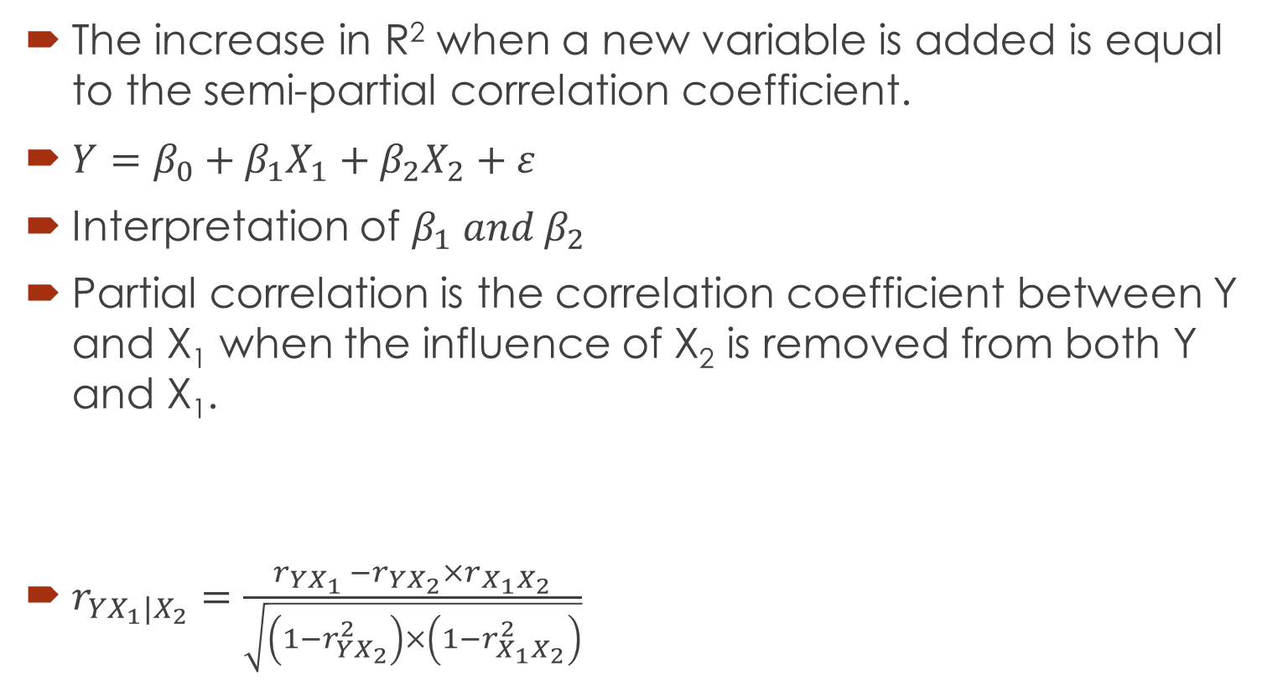
Partial Correlation
The increase in R² when a new variable is added is equal to the semi-partial correlation coefficient.
$Y=β_{0}+β_{1}X_{1}+β_{2}X_{2}+ε$
Interpretation of $β_{1} and β_{2}$
Partial correlation is the correlation coefficient between Y and X₁ when the influence of X₂ is removed from both Y and X₁.
$r_{YX_{1}{|X}_{2}}=\frac{r_{YX_{1} }−r_{YX_{2}}×r_{X_{1}X_{2}}}{\sqrt{\left(1−r_{YX_{2}}^{2}\right)×\left(1−r_{X_{1}X_{2}}^{2}\right)}}$
Corr(Y,X₂)
Corr(X₁,X₂)
Partial Corr
Corr(Y,X₁)

Slide 20
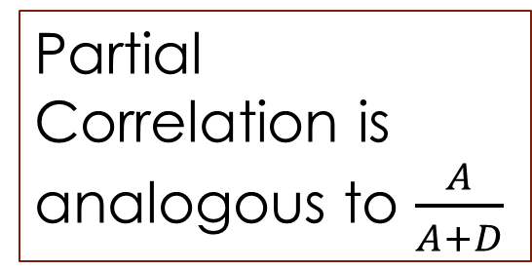
Partial Correlation
Remove the influence of X₂ from Y and X₁.
i,.e., remove B, C and E
Y
D
Partial Correlation is analogous to $\frac{A}{A+D}$
A
B
C
F
E
G
X1
X2

Slide 21
Goodness of fit
Adding more explanatory variables increases the “explanatory power” of the model, i.e., it always increases R², even if by a small amount
Adjusted-R² accounts for the degrees of freedom, and penalizes more complicated models, where additional variables might not be adding a lot more explanation

Slide 22
Regression with all Independent Variables
Regression Statistics
Multiple R | 0.9987
R Square | 0.9973
Adjusted R Square | 0.9961
Standard Error | 1454.3876
Observations | 20
ANOVA
 | df | SS | MS | F | Significance F
Regression | 6 | 10,30,77,39,449 | 1,71,79,56,575 | 812.1792 | 0.0000
Residual | 13 | 2,74,98,163 | 21,15,243
Total | 19 | 10,33,52,37,613
 | Coefficients | Standard Error | t Stat | P-value | Lower 95% | Upper 95%
Intercept | 4845.82 | 17422.50 | 0.28 | 0.79 | -32793.21 | 42484.85
MATERIAL | 1.20 | 0.12 | 10.26 | 0.00 | 0.95 | 1.46
T2 | 63.66 | 40.91 | 1.56 | 0.14 | -24.73 | 152.04
OTINC | 2.85 | 0.61 | 4.69 | 0.00 | 1.53 | 4.16
EMPL | -0.18 | 1.32 | -0.14 | 0.89 | -3.03 | 2.67
INT | 0.03 | 1.51 | 0.02 | 0.99 | -3.24 | 3.29
T | -350.67 | 935.03 | -0.38 | 0.71 | -2370.69 | 1669.35

Slide 23
Regression with only Significant Variables
Regression Statistics
Multiple R | 0.9985
R Square | 0.9970
Adjusted R Square | 0.9964
Standard Error | 1395.6099
Observations | 20
ANOVA
 | df | SS | MS | F | Significance F
Regression | 3 | 10,30,40,73,980 | 3,43,46,91,327 | 1763.4357 | 2.278E-20
Residual | 16 | 3,11,63,633 | 19,47,727
Total | 19 | 10,33,52,37,613
 | Coefficients | Standard Error | t Stat | P-value | Lower 95% | Upper 95%
Intercept | 733.93 | 495.70 | 1.48 | 0.1581 | -316.91 | 1784.77
MATERIAL | 1.29 | 0.08 | 15.92 | 0.0000 | 1.12 | 1.46
T2 | 35.34 | 7.66 | 4.61 | 0.0003 | 19.09 | 51.58
OTINC | 3.19 | 0.47 | 6.83 | 0.0000 | 2.20 | 4.19

Slide 24
Assumptions of Multiple Regression
All the assumptions of the SLR model are required
  Linear specification is correct: Y = β₀ + β₁X + ε
  Errors are uncorrelated with explanatory variables: E[ε|X] = 0
  Constant variance of errors: Var[ε_{i}]= σ_{ε}²
  Errors are independent of each other: Corr[ε_{i}, ε_{j}] = 0
  Error term is normally distributed: ε_{i} ~ N (0, σ_{ε}²)
In addition, no predictor variable should be a linear combination of other predictor variables – no multicollinearity
  e.g. We do not want the situation like: X₂ = 3X₁ + 7.2X₃ – 0.54X₄
  Here, if we regress X₂ against X₁, X₃, X₄ we will get R² = 1
  All variation in X₂ is explained by other variables

Slide 25
Checking Assumptions (Similar to Simple Regression)
Actual Vs. Predicted Y
Residuals Vs. Predicted Y
We can use residual plots to detect the following:
Nonlinearities, heteroskedasticity, dependence/autocorrelation, non-normality

Slide 26
Questions?

